Slide 1
YORUBA

Slide 2
African language academy 2023
A structured set of lessons to give beginners a basic level of understanding and conversational skills in Yorùbá
Lesson 1

Slide 3
Introduction and Greeting
E kaabo sì kíláàsì Yoruba!
Welcome to Bemba class!
Bawo ni? How are you?
Dáadáa ni mo wa
I am fine

Slide 4
Spelling and Pronunciation
Yorùbá is a tone language.
This means that words spoken with different tone patterns can mean different things. However, this is not reflected in spelling. *Therefore you have to pay attention to the tone when someone speaks*. Eg ilé-house
Ilẹ̀- land

Slide 5
Important points to note
There is no c, q, v, x, or z in the Yoruba alphabet, it 25 in total
Words in Yorùbá do not usually begin with ‘h’. When ‘h’ any other consonant word, it is usually succeeded by a vowel. 2 vowel can start a word also,except U it a dialect, it not usually use in general language eg ule(house), ugbàlè (brom).
Vowel pronunciation
a – ah as in ah( abo – plate)
e – e as in hey (edé – Crayfish )
ẹ - ẹ as in hen (ẹja – fish)
I – ee as in he (Ilé – house)
o – o as in oh(Owo - money)
ọ - ọ as in or ( ọwọ-hand)
u - oo as in uh (U is not usually used alone as a sentence or word,except in a dialect, eg ule ( house)

Slide 6
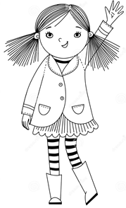
Common greeting (basic)
Bí a ṣe kí èèyàn towotowo
a polite address towards others
Bawo ni?
How are you?
Dáadáa ni mo wa,iwo n ko?(younger
Dáadáa ní mo wà,èyí ń kó?(older
I am fine and how are you?
Ṣé àlãfíà lọ wà?
are you well?
Rárá, ó ré mi
No, iam ill
O dáàbò, a rira ni ola
Goodbye, see you tomorrow
Wa gùn lè l’ayo, ó di ola
travel safely, see you tomorrow

Slide 7
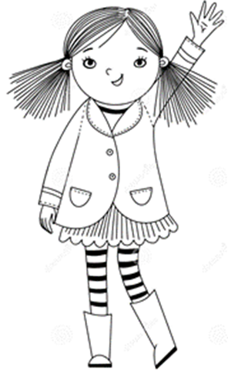
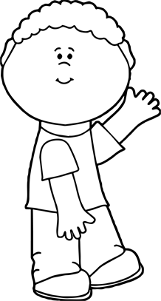
Tell me about yourself – sọ ní paa rẹ fún mi
My name is Aanu Olukomaiya
Orúkọ mi ni Àánú Olukomaiya
Iam a girl
Ọmọdébìnrin ni mi
Iam a boy
Ọmọdékùnrin ni mi
Iam ten years old
Omo ọdún mewa ni mi
I live in Australia
Ilu Australia ni mo ń gbe
Tell me something about yourself
Sọ ni pa rẹ fún mi

Slide 8
Practical activity
Greet everyone in the class using Yoruba Language

Slide 9
Homework
Tell us about yourself using four sentences in Yoruba in the next lesson.

Slide 10
End of first lesson
**The only way to be conversant in a language is to practise speaking**

