Slide 1
Yoruba

Slide 2
African Language Academy 2023
A structured set of lessons to give beginners a basic level of understanding and conversational skills in Yorùbá
Lesson 2 1. Greetings in different scenarios
2. Key words in questions

Slide 3
Homework from Lesson 1
Can you tell us about yourself using four sentences in Yorùbá?

Slide 4
Greetings in different scenarios
Kaaro, se daadaa lọ jí? Goodmorning/ How did you wake?
Báwo ni, ẹ kú isé o Greetings (To somebody at work)
Bawo ni, e n le ni be yẹn/ e ku igbadun Greetings (To somebody eating or resting
O dáàbò Goodbye
A tú máa rírà lola See you tomorrow
À wá yẹ ọkọ̀/ wá gunle layo Safe journey
Response to all of the above – ìdáhùn sí gbogbo e

Slide 5
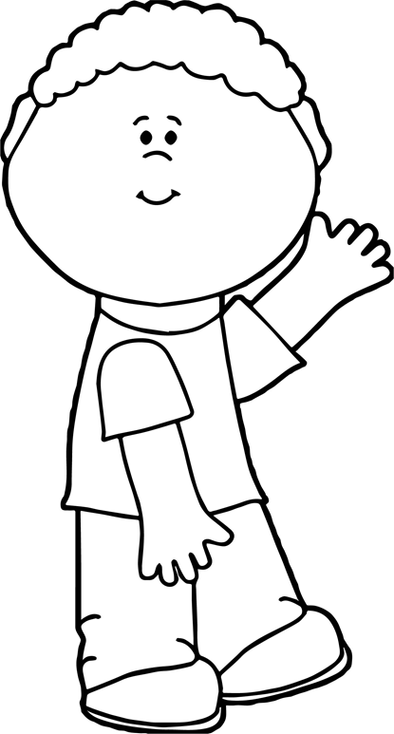
E ku ile o?
or e n le ni be yen o?
Loosely translated as ‘knock knock’
O/kaabo!
O/kaabo/wọ’lé means ‘you are welcome’ or ‘You can come in’
Ku ile’ is a Yoruba way to announce your presence when you visit someone

Slide 6
Key words in questions
Kilode tabi kini?
Why or what
Kilode can used to ask what? Or why? Interchangeably. For example,
Kilode ti o fi n rerin? Kini o fà erin
Why are you laughing?/
What are you laughing at?e.g. a dog is dancing (ajá n jó)
Kini o fe?
What do you want?

Slide 7
Key words in questions
Who? - tani? or tani yen?
When asking about people;
Tani eléyìí?
who is this one?
Tani yẹn?
who is that one?

Slide 8
Key words in questions
E lo? How much?
The word e lo can be used to ask for a price(s) when shopping
E lo ni?
Adìẹ (chicken) ìgbá (garden eggs)
Ṣòkòtò (trousers) Kèké (bicycle)
Ewé elegede(pumpkin leaves)
Eran (beef) ẹja (fish)
Moto (car) esé adìẹ (chicken feet)

Slide 9
Homework
Read the following names of food items, common things and animal names
How many items will you remember in the next lesson?

Slide 10
Vocabulary
Food
Tomati- Tomato
adie - chicken
Odunkun - sweet potatoes
Èpà - peanuts
Ewé elegede - pumpkin leaves
Eran - meat
Eja - fish
- relish
Ese elédè - trotters
Animals
Adie- a chicken
Ejò - a snake
Kìnìún - a lion
erin - an elephant
Ònì - a crocodile
Pepeye - a duck
Ologbo - a cat
Eye – a bird
Òbọ - a monkey
Ekute – a rat
oyin – bees
Màálù- a cow
Ajá a dog
Ewúré – a goat
Common things
oúnjẹ – food
aṣọ – clothes
bata – shoes
Bagi/apamowo – a bag
Òdòdó – flowers
Owó – money
omi – water

Slide 11
End of lesson 2
Ìparí kíláàsì **The only way to be conversant in a language is to practise speaking**

