Slide 1
Yoruba

Slide 2
AFRICAN LANGUAGE ACADEMY AUSTRALIA 2023
A structured set of lessons to give beginners a basic level of understanding and conversational skills in Yorùbá
Lesson 3 1. Naming parts of the body in Yoruba Language
2. Building Vocabulary

Slide 3
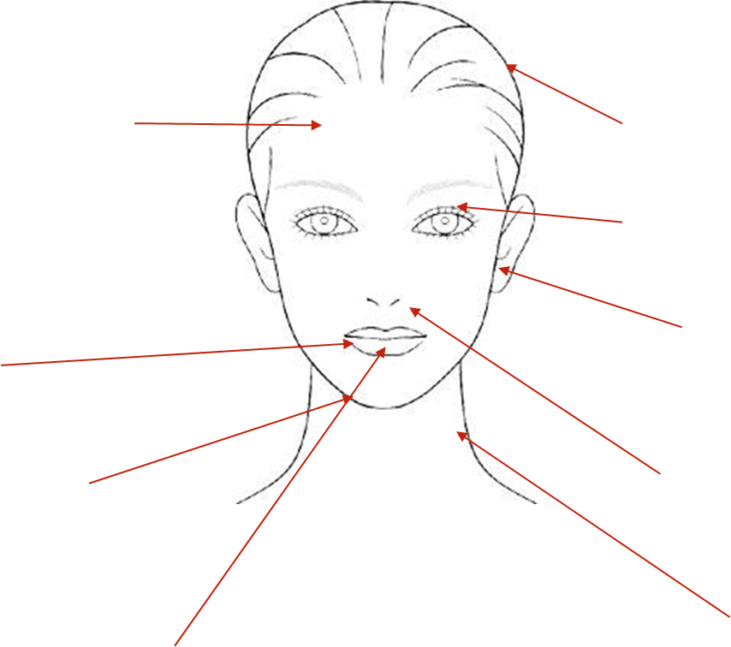
Orí - The Head
Agbari orí-forehead
Irun - hair
Ojú- eyes
Ojú - eye
Pẹpẹ ojú - eyelashes
Etí -ear/ ears
Ètè - lips
agbon - chin
Imú
nose/noses
Ẹnu- mouth ọrùn - neck

Slide 4
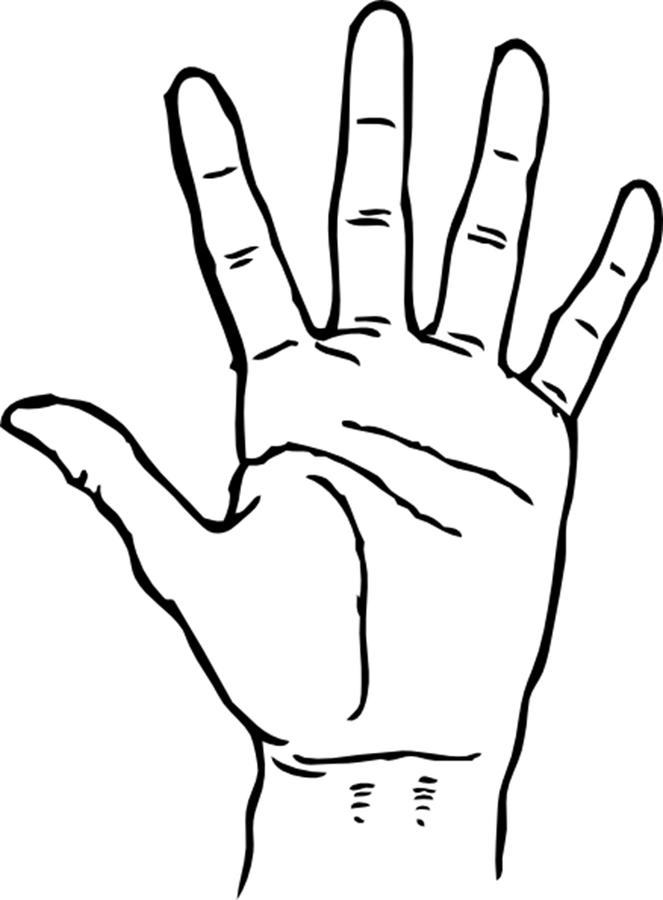
Owó - Hand
Ìka owó - fingers
Ìka kan - one finger
Àtàǹpàkò - thumb
Ọrùn owó-wrist

Slide 5
End of lesson 3
Ìparí kíláàsì kẹta
**The only way to be conversant in a language is to practise speaking**

